Slide 1
The Decentralisation of Blockchain Governance
Mustafa Tene Nzokou
Notes:
I’ll start with some context and terminology

Slide 2
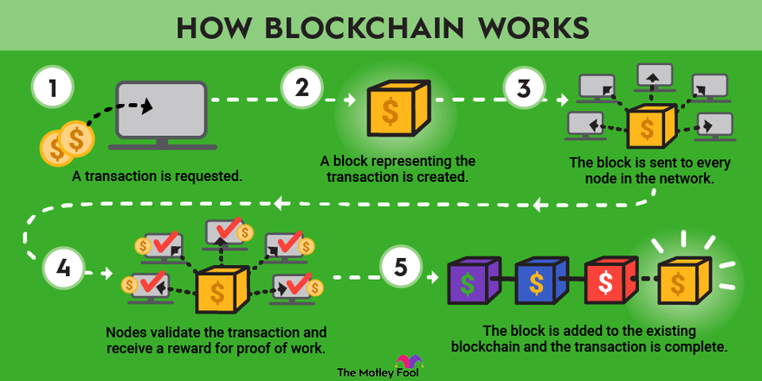
What is Blockchain
Distributed digital ledger
Peer-to-peer, no central authority
Immutable and transparent
Notes:
A blockchain is a distributed ledger with growing lists of records that are securely linked together via cryptographic hashes. Each block contains a cryptographic hash of the previous block, a timestamp, and transaction data. Since each block contains information about the previous block, they effectively form a chain, with each additional block linking to the ones before it. Consequently, blockchain transactions are resistant to alteration because, once recorded, the data in any given block cannot be changed retroactively without altering all subsequent blocks and obtaining network consensus to accept these changes.

Slide 3
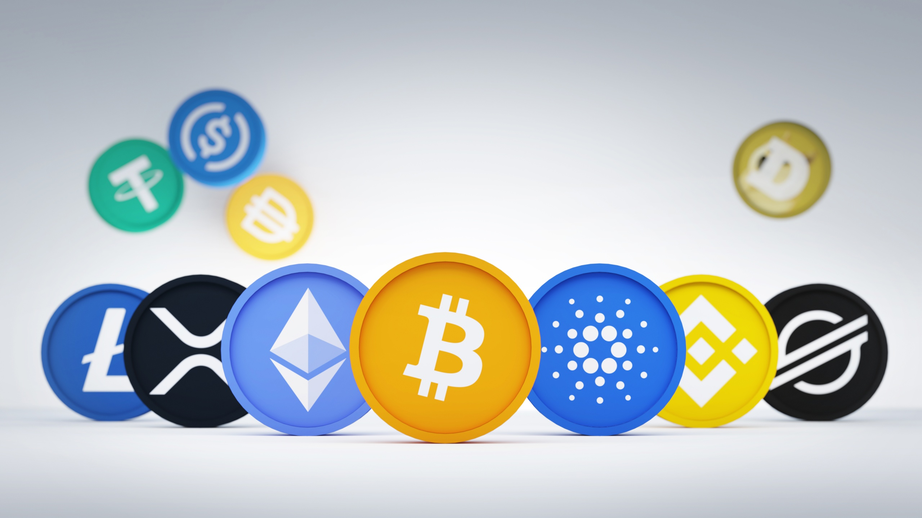
What are Tokens
A unit of value on a blockchain
Used for payments, governance, access

Slide 4
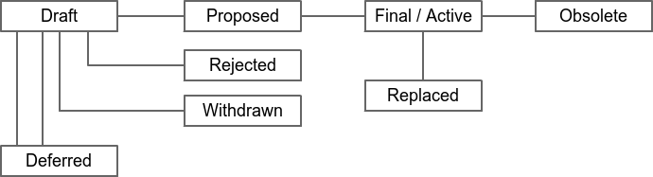
What is Governance
Bitcoin governance process:
Changes proposed and reviewed through improvement proposals
BIPs (Bitcoin), EIPs (Ethereum), CIPs (Cardano)
Ideally decentralised, often centralised in practice
Notes:
Governance is how blockchains change over time — or at least try to. Ideally, it’s a democratic process. In reality, it can be more like 'whoever codes fastest and yells the loudest on GitHub wins.

Slide 5
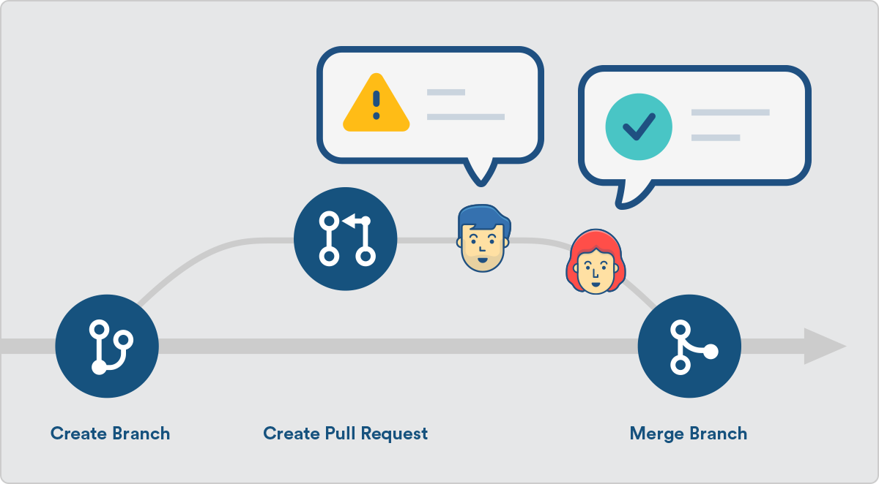
The Role of GitHub
Online code collaboration platform
Hosts and tracks governance activity
Interactions = pull requests, comments, reviews
Notes:
GitHub is where developers collaborate — and where all governance activity for many blockchains happens

Slide 6
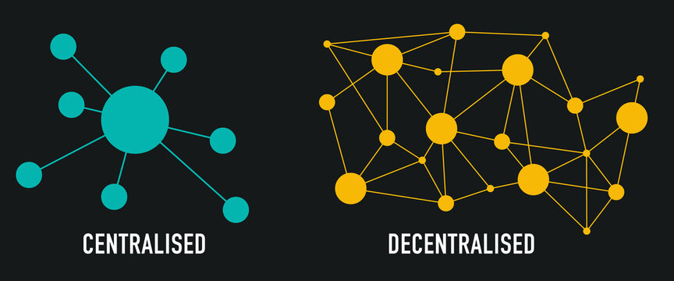
What is Decentralisation
Power distribution across multiple layers
Stratified framework: governance, software, network, etc.
It's a spectrum, not a binary
Notes:
It’s about how power is distributed across various layers. The framework I used — from Ovezik et al. — breaks it into layers like governance etc.

Slide 7
Why Does it Matter
Centralised governance = risk of failure or control
Many projects claim decentralisation without measuring it
My research brings data to the hype
Continuation of the work started in the Stratified Approach to Blockchain Decentralization
Notes:
Projects boast about being decentralised, but don’t actually check if they are. My dissertation tries to fill that gap — using real data and network analysis to ask: who actually has power here?

Slide 8
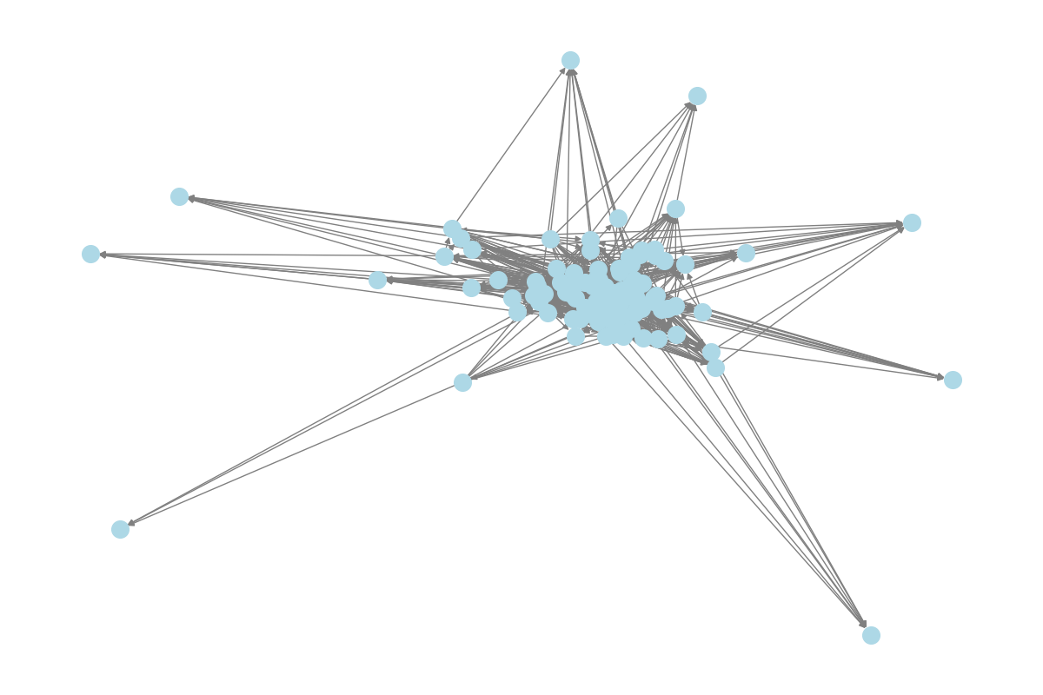
How My Project Fits In
Network Graph of Bitcoin
Studied Bitcoin, Ethereum, Cardano
Scraped GitHub for governance interaction data
Applied social network analysis + Gini coefficient
Notes:
My work analyzes how contributors interact in governance — who reviews, who comments, who gets ignored. I used centrality metrics to detect influence patterns, and inequality tools to see if these systems were dominated by a few people.

Slide 9
Key Terms
Token
Decentralisation
Governance
GitHub
Pull Request
Betweenness Centrality
Gini Coefficient
Notes:
Degree: A measure of how many direct connections a user (or node) has in a network. In the context of blockchain governance, it shows how active or visible someone is — like how many pull requests they comment on or review. Simple version: The more people you interact with, the higher your degree centrality. It’s basically measuring how loud you are in the room.
Gini: A number between 0 and 1 that measures inequality in a distribution. 0 means perfect equality (everyone is equally important), and 1 means total inequality (one person is the king of everything). Simple version: It's how we measure whether influence in a network is shared or hoarded.
So, to sum up: blockchains promise open governance, but often deliver developer fiefdoms. My project tries to quantify that power — not just claim it. Hopefully this gives you the background needed before we dive into the methods and results.

Slide 10
My Project
Methodology and Results

Slide 11
What Was I Trying to Find Out?
How decentralised are blockchain governance processes really?
Can we measure it using open-source contribution data?
Comparative study: Bitcoin, Ethereum, Cardano
Notes:
"My main question was simple but brutal: are blockchain governance processes actually decentralised, or is that just marketing? And if they aren't, can we prove it using real-world data instead of guesswork?"

Slide 12
Where I Got My Data
Scraped GitHub Improvement Proposal repositories
Pulled metadata: comments, reviews, users, dates
Custom Python scraper using GitHub API
Notes:
I scraped GitHub repositories for Bitcoin (BIP), Ethereum (EIP), and Cardano (CIP). Pulling metadata like who commented, who reviewed, and when

Slide 13
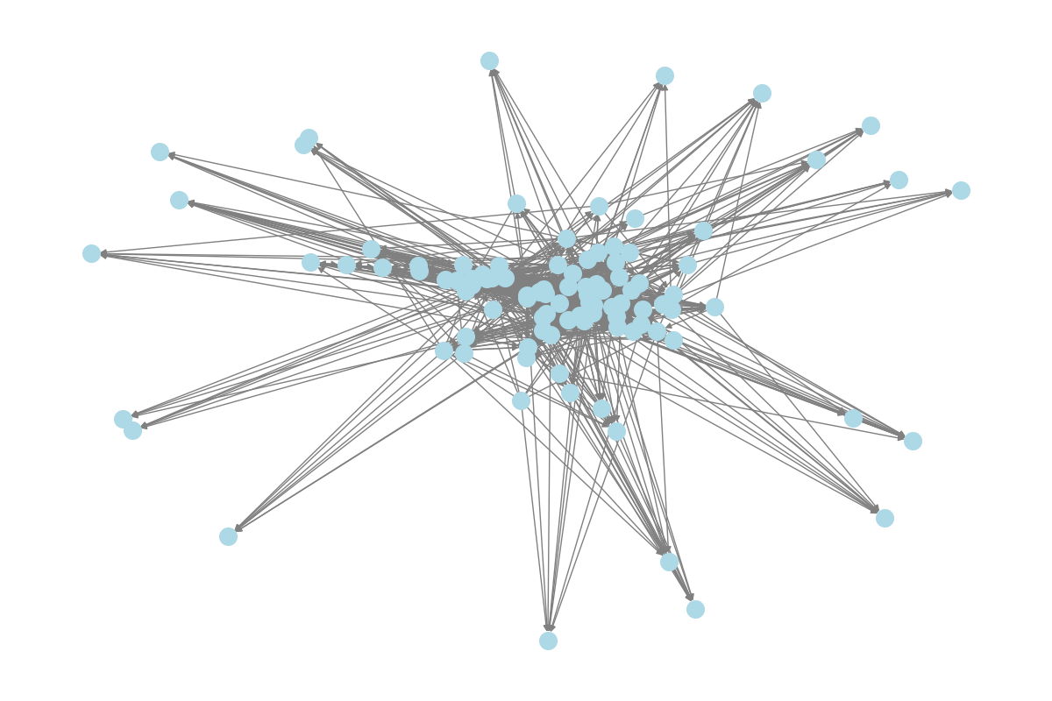
Turning Data into Graphs
Ethereum Graph
Each user = a node
Interactions (comments, reviews) = edges
Weighted edges: Reviews = 5 points, Comments = 1 point
Notes:
To distinguish between the different levels of influence exerted through interactions, I applied weighted edges to the network graph. Comments were assigned a base weight of 1, while reviews were given a weight of 5, reflecting their elevated significance in the governance process — as reviews typically represent active moderation, authority, or gatekeeping power, while comments are more casual or advisory in nature. The chosen weights are not empirically derived, but they serve as a simple heuristic to introduce asymmetry reflective of practical influence differences.

Slide 14
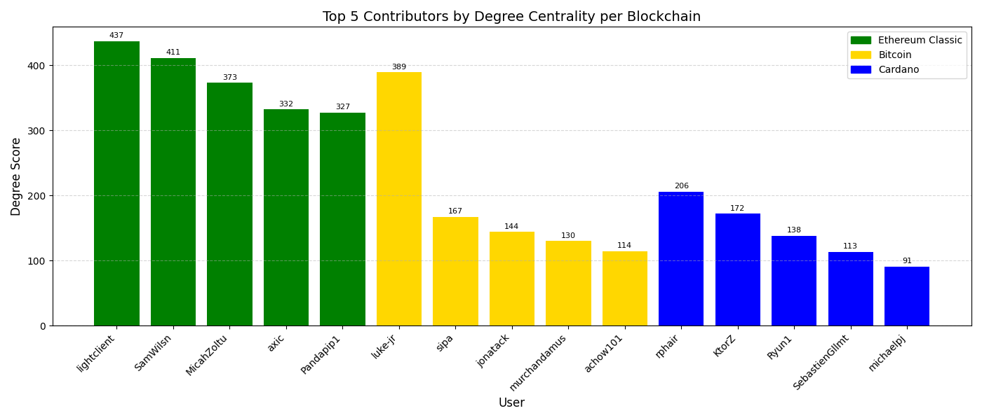

Slide 15
How I Measured Influence
Degree Centrality: How many people a user interacts with
Betweenness Centrality: How often a user connects others
Gini Coefficient: Overall inequality of influence

Slide 16
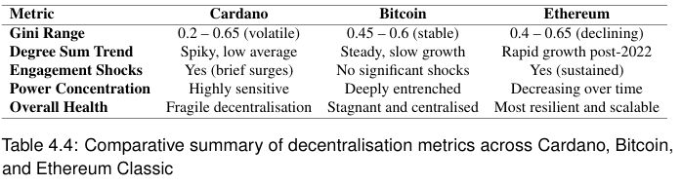
Results – Activity and Centralisation
Notes:
Ethereum had the liveliest activity. Bitcoin was steady but cliquey. Cardano was very volatile and had spikes of activity and inactivity.
Bitcoin dominated by a few (esp. luke-jr)
Ethereum influence spread more evenly
Cardano: few heavy hitters during low-activity periods
Bitcoin: Consistently high Gini (centralisation)
Cardano: Volatile Gini (bursts of decentralisation)
Ethereum: Gini dropped over time (better participation)

Slide 17
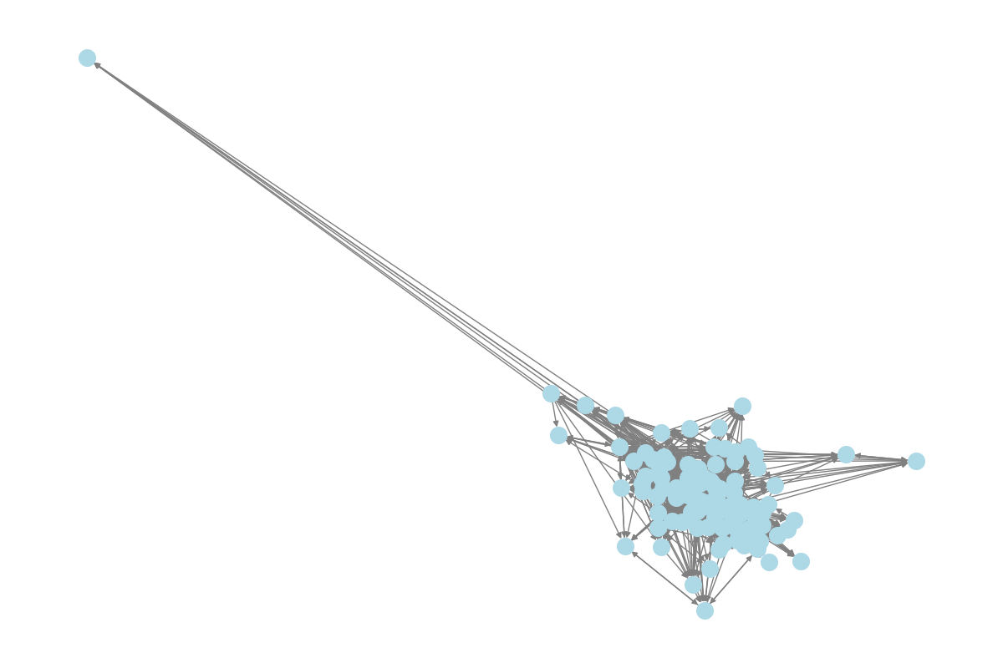
Results – Network Graphs
Ethereum Graph
Cardano: Central clique with outsiders orbiting
Bitcoin: Same, but even tighter circle
Ethereum: More web-like, broader contributor base

Slide 18
Results - Summary
Blockchain governance often centralises despite the decentralisation hype
Bitcoin and Cardano are highly vulnerable
Ethereum shows signs of scalable governance

Slide 19
Recap and Conclusion
Methodology:
Data Source: Scraped GitHub repositories (Bitcoin, Ethereum, Cardano) for improvement proposal activity.
Network Model: Users = nodes, Comments/Reviews = edges (Reviews weighted heavier).
Metrics Used:
Degree Centrality: Who interacts the most.
Betweenness Centrality: Who controls connections.
Gini Coefficient: How unequal the influence is.
Results:
Bitcoin: Centralised clique; a few users dominate governance.
Cardano: Fluctuating centralisation; bursts of activity but fragile participation.
Ethereum: Broad, resilient network; decentralisation improving over time.
Overall:
Decentralisation is not guaranteed.
Governance can re-centralise easily without active community engagement.

Slide 20
Thank you
Any questions?

